Slide 1

Learnify Me
An innovative educational platform

Slide 2
Team 6
Thanmayee Vempati
Itaraju Kavya Priya
P.Bhavya Sri
A.Ruthvika

Slide 3
Course Outline
Introduction
Mission and Goals
Benefits
Procedure
Conclusion

Slide 4
Introduction
Mission: Empowering learners through innovative online resources.
Vision: Revolutionizing education through accessible and engaging platforms.
It is an innovative online learning platform designed to provide engaging and effective educational resources to learners of all ages.
A diverse range of courses spanning various subjects and skill levels, Learnify Me aims to empower individuals to pursue their learning goals at their own pace and convenience.
Through interactive lessons, quizzes, and multimedia content, learners can acquire new knowledge and skills in a fun and interactive way.
Introduction
Mission and Goals
Procedure
Conclusion

Slide 5
Mission and Goals
Leveraging the power of the MERN (MongoDB, Express.js, React, Node.js) stack, we aim to create a dynamic and interactive platform that empowers learners to unlock their full potential through lifelong learning.
Accessibility: We aim to make education accessible to learners of all backgrounds, regardless of geographic location, socioeconomic status, or physical limitations.
Quality: We are committed to delivering content that meets the highest standards of educational excellence, ensuring that learners receive valuable and impactful learning experiences.
Diversity: We strive to offer a diverse range of courses and learning materials to cater to the varied interests and needs of our global audience.
Flexibility: We provide flexible learning options that allow individuals to learn at their own pace, on their own schedule, and from any location with internet access.
Innovation: We continually innovate and adapt to incorporate the latest advancements in educational technology and pedagogy, enhancing the learning experience for our users.
Mission and Goals
Introduction
Procedure
Conclusion

Slide 6
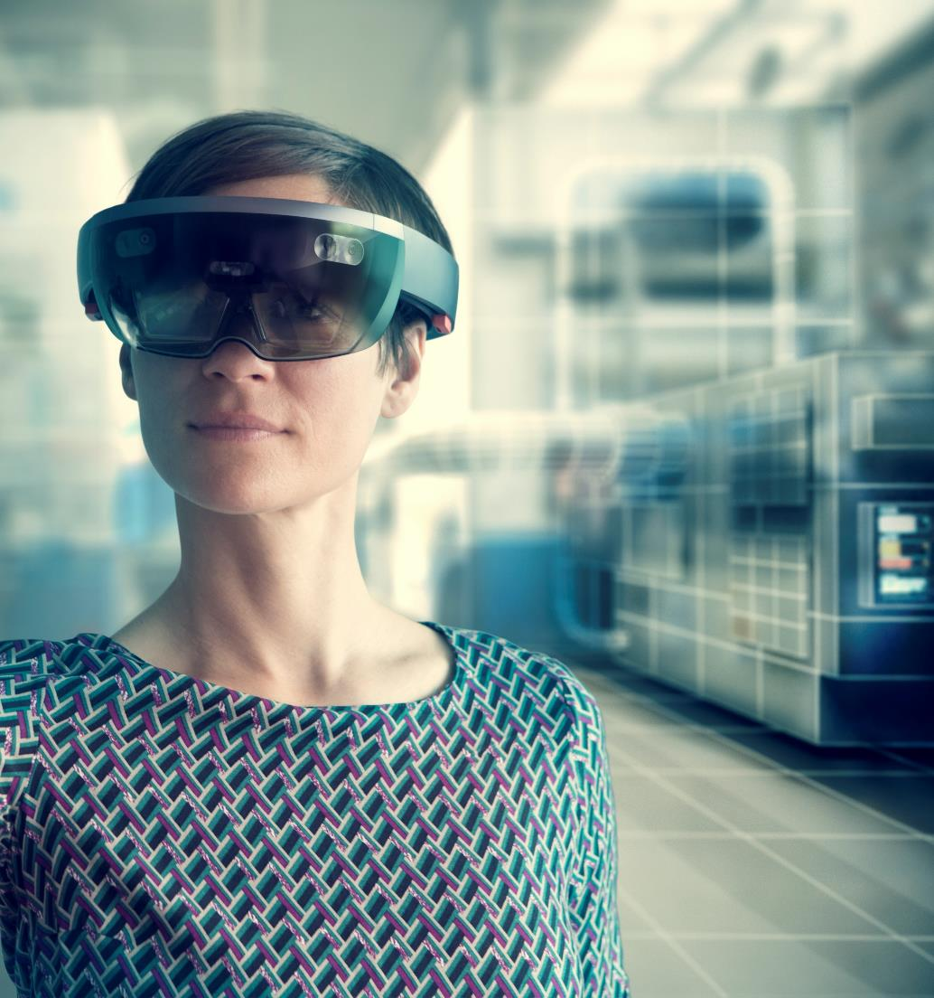
How is it useful for users?
Flexible Learning: Users can access courses at their own pace and convenience, fitting learning around their busy schedules.
Wide Range of Topics: With a diverse selection of courses spanning various subjects and skill levels, Learnify Me caters to a broad range of interests and learning goals.
Accessible Anywhere: As an online platform, Learnify Me can be accessed from anywhere with an internet connection, enabling learning on-the-go.
High-Quality Content: Courses on Learnify Me are curated to ensure high-quality content, providing users with valuable knowledge and skills.
Interactive Learning: Many courses feature interactive elements such as quizzes, assignments, and multimedia content, making the learning experience engaging and enjoyable.
Community Interaction: Users can engage with instructors and fellow learners through discussion forums and collaborative projects, fostering a sense of community and facilitating peer learning.
Professional Development: Learnify Me offers courses that help individuals enhance their professional skills and advance their careers, making it a valuable resource for lifelong learning and career growth.
Introduction
Mission and Goals
Procedure
Conclusion

Slide 7
Procedure
Go to the LEARNFY ME website.
Click on the 'Sign Up' button.
Fill out the registration form with your personal information.
Create a username and password.
Click 'Submit' to complete the registration process.
Navigating the Website
After logging in, you will be directed to the homepage.
From the homepage, you can access different sections of the website, such as courses, tutorials, and resources.
Use the navigation menu at the top of the page to easily switch between sections.
Accessing Learning Materials
Once you are logged in, you can browse through the available courses and tutorials.
Click on a course or tutorial to access the learning materials.
Each course or tutorial will have a series of lessons or modules.
Click on a lesson or module to view the content and complete the exercises.
Track your progress and achievements in your user profile.
Procedure
Introduction
Mission and Goals
Conclusion

Slide 8
Summary
Learnify Me is an innovative online learning platform with a mission to democratize education and empower individuals worldwide to pursue their learning goals.
By offering a wide range of high-quality courses, flexible learning options, and interactive content, Learnify Me provides users with a valuable and accessible learning experience.
Whether users are seeking to develop new skills, explore new interests, or advance their careers, Learnify Me offers a platform for lifelong learning and personal growth.
With its commitment to accessibility, quality, diversity, and innovation, Learnify Me stands as a valuable resource for individuals looking to unlock their full potential through education.
Conclusion
Introduction
Mission and Goals
Procedure

